Slide 1




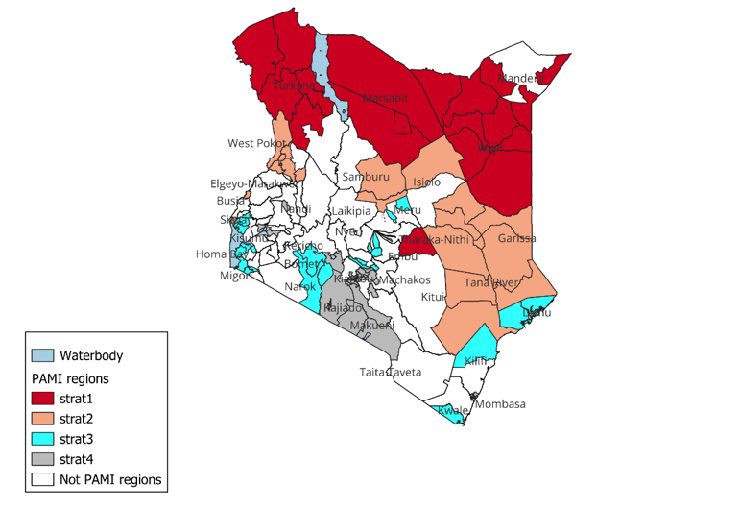
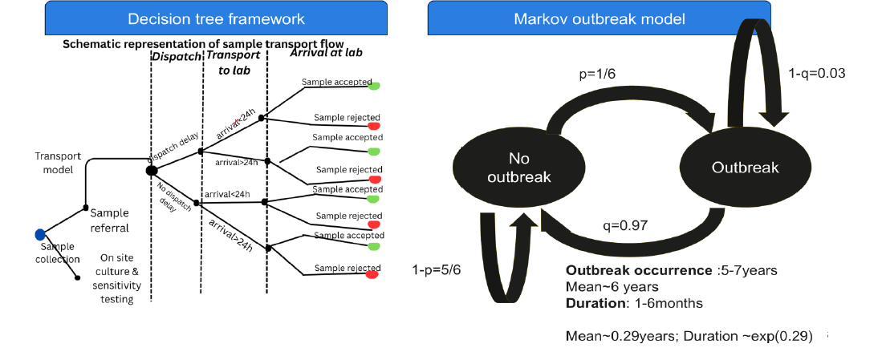
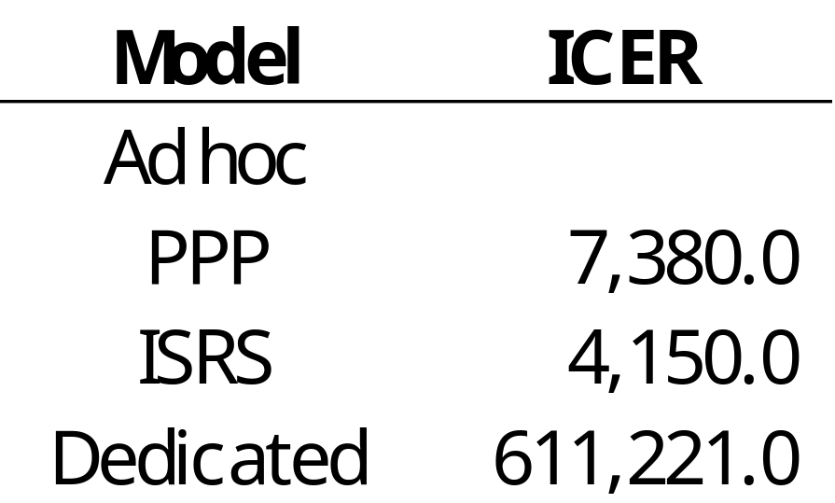
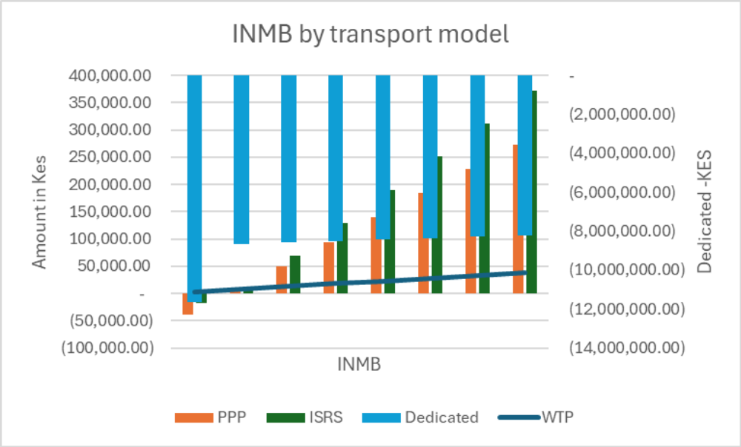
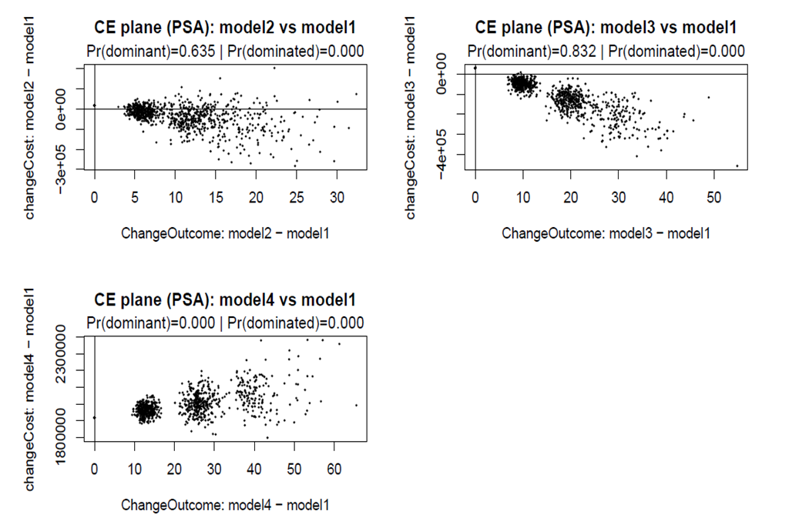
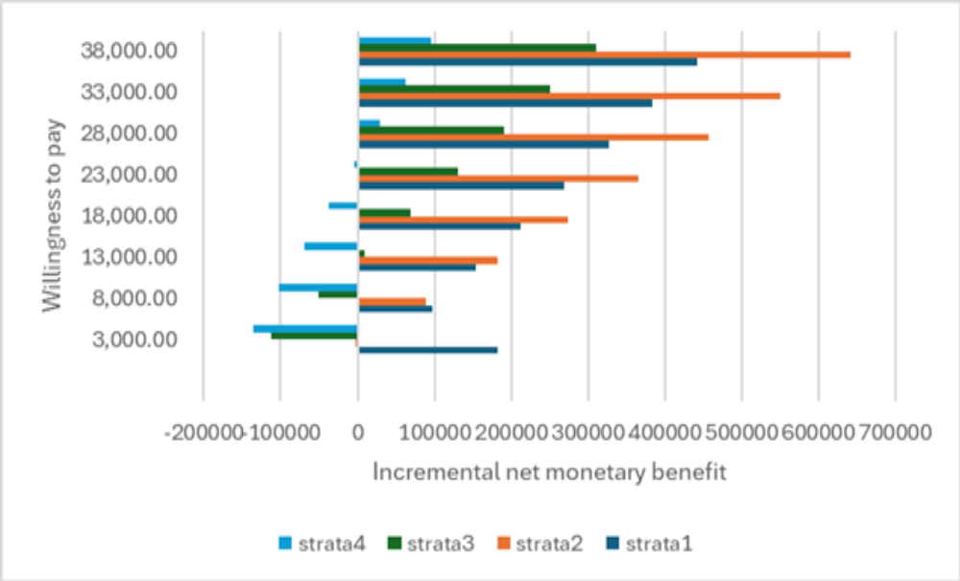
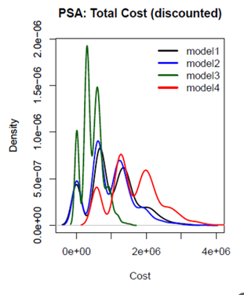
Cost effectiveness analysis for strengthening outbreak response in priority sub-counties
Dr. Matabel Odin Odiaga¹ , Dr. Kanana Kimonye² Dr. Kadondi Kasera³
^{1:} Department of Mathematics, Statistics and Actuarial Science, Namibia University of Science and Technology, Windhoek, Namibia ²:Kenya National Public Health Institute, Nairobi, Kenya ³: Tackling Deadly Diseases in Africa Programme 2 (TDDAP2), Nairobi, Kenya
BACKGROUND
Cholera remains recurrent in Kenya (every 5–7 years), concentrated in vulnerable hotspots; response is guided by NMCEP (2022–2030) and operationalized through PAMI (2024), which identified 107 hotspot sub-counties (~40% population) to strengthen surveillance and outbreak response
Surveillance depends on transporting samples to laboratories, but current systems are ad hoc and fragmented, causing delays and inefficiencies, with limited evidence on the cost-effectiveness and sustainability of alternative transport models.
OBJECTIVE: To evaluate the cost-effectiveness of alternative cholera sample transport models and identify the most efficient and sustainable strategy
METHODOLOGY: Stratified Cost-effectiveness Analysis (CEA)
Healthcare system perspective; 10-year horizon; 3% discount rate; base year 2025; stratified by transport accessibility and complexity; primary and secondary cost and outcome data
STUDY AREA: 107 PAMI sub-counties, Kenya
STUDY DESIGN AND SCOPE
Model structure Transport Strategies
Ad hoc
PPP
ISRS
Dedicated
Courier-based
Fragmented / reactive
Integrated system
Assigned transport
ANALYSIS: Incremental Cost Effectiveness Ratios (ICER), Incremental Net Monetary Benefit (INMB), Sensitivity, Equity & Sustainability Analysis
RESULTS
DISCUSSION
ICER
INMB
ISRS ranked as the most cost-effective strategy ( lowest ICER)
Largest gains in lower-access settings(strata 1 and 2)
Results robust under uncertainty (ISRS maintains dominance)
Dedicated transport offers marginal gains at a substantially higher cost- Economically unattractive
Findings align with PAMI objectives of early detection and efficient resource use
PSA
Equity Analysis
CONCLUSIONS
Model1= ad hoc
Model2 = PPP
Model3= ISRS
Model4= Dedicated
ISRS is the most cost-effective, equitable, and fiscally sustainable strategy for strengthening cholera surveillance.
Supports transition from reactive → structured, integrated transport systems
Prioritize investments in hard-to-reach areas
Sustainability Analysis
Contact: modiaga@nust.na

